Slide 1

Deep Learning-Image Classification
CNN - Transfer Learning
Team Members :
Bader - Shatha - Faisal - Aryam

Slide 2
Project Overview
Data Preprocessing
CNN Modeling
Transfer Learning Modeling
CIFAR-10 dataset, which contains 60,000 images
Designed a custom CNN with Conv2D, MaxPooling2D, and Dense layers
Used VGG16 to benchmark against our custom CNN model.
Resized images
Normalized
Evaluated the models using accuracy, precision, recall, and F1 score.
Evaluated the models using accuracy, precision, recall, and F1 score.
data augmentation
Visualized results using confusion matrices and sample predictions.
Visualized results using confusion matrices and sample predictions.

Slide 3
Objective
To build and compare the performance of two deep learning models
Convolutional Neural Network (CNN)
Transfer learning model
From the CIFAR-10 dataset into 10 distinct classes

Slide 4

Data Preprocessing

Slide 5
Data loading
Normalized
Resized images
Data augmentation
Loading CIFAR-10 dataset
Converts the pixel values of the images from integers (uint8, range 0-255) to floating-point numbers (float32, range 0.0-1.0).
To use pre-trained models, you need to resize your images to the expected input size
technique used to artificially increase the size and diversity of your training dataset by applying random transformations to the existing data

Slide 6
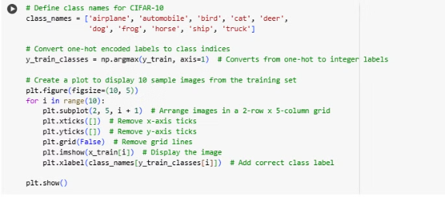
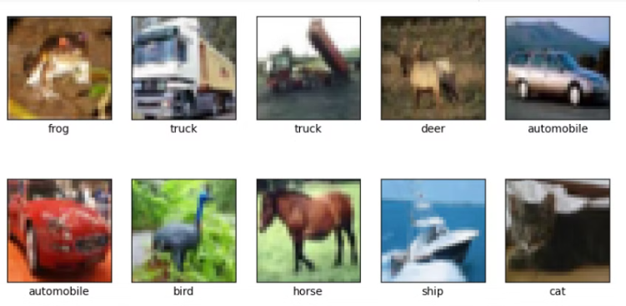
To ensure the data has been loaded and preprocessed correctly

Slide 7

CNN Modeling

Slide 8

CNN Layers
1
convolutional layers
2
pooling layers
3
fully connected layers

Slide 9
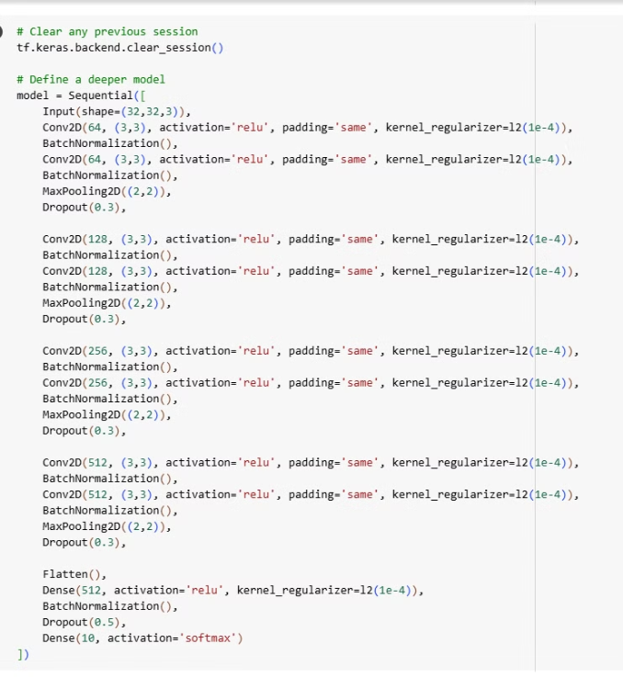
Input: (32, 32, 3).
4 Conv2D blocks with increasing filters (64 → 128 → 256 → 512).
Each block:
2 Conv2D layers (kernel size: 3x3, activation: ReLU, padding: same).
Batch normalization.
MaxPooling2D (2x2).
Dropout (0.3).
Fully Connected Layers:
Flatten → Dense (512 units, ReLU) → Batch normalization → Dropout (0.5) → Output (10 units, softmax).
Total Parameters: 5.7M (21.93 MB).

Slide 10
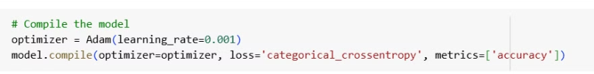
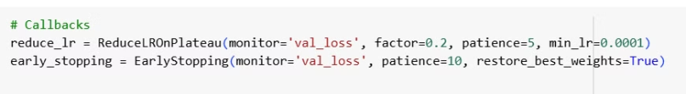
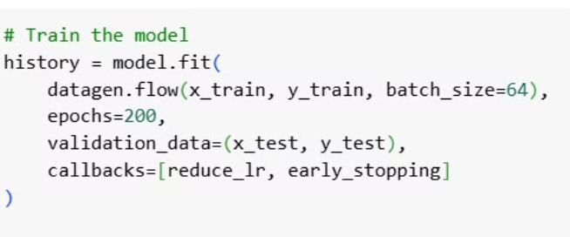
Model Training
Optimizer techniques: Adam
Utilize techniques: Early stopping
Train model: fit
Batch Size: 64.
Epochs: 200 (stopped early at epoch 96 due to early stopping).

Slide 11
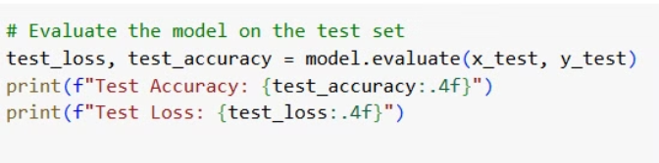
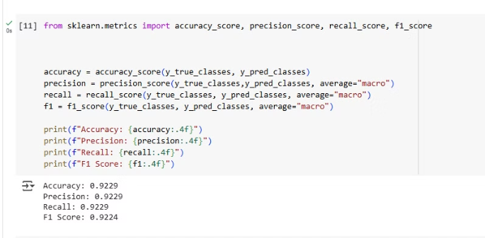
Model Evaluation
1- Evaluate the trained model on a separate validation set
2- Compute and report metrics
such as accuracy, precision, recall, and F1-score

Slide 12
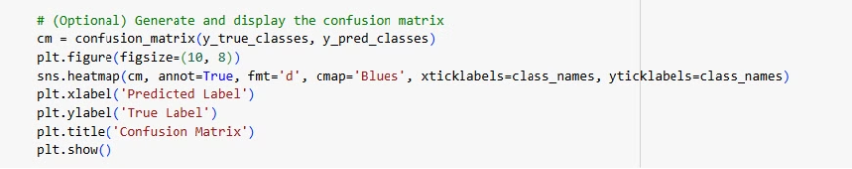
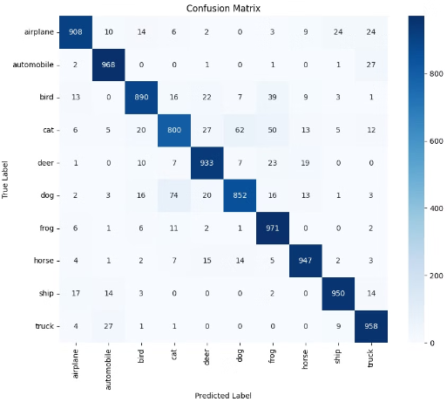
Model Evaluation.(Cont)
3- confusion matrix
output confusion matrix

Slide 13
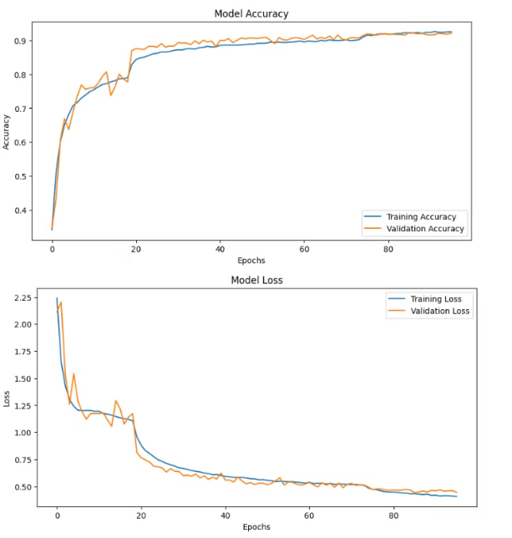



92.71%.
92.15%
0.4037
Training accuracy
Validation accuracy
Validation loss

Slide 14
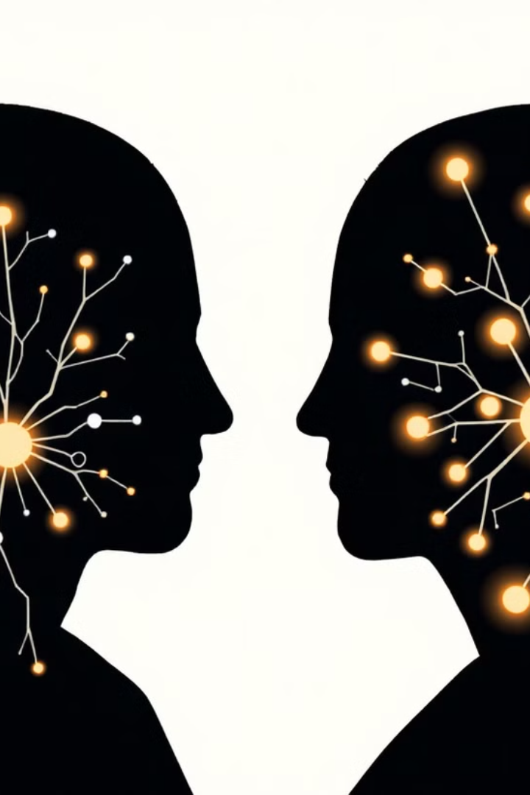
Transfer Learning Modeling

Slide 15



Overview Transfer Learning Works
Model Architecture
Training a model on a large dataset using substantial computational resources.
Model Training
Use a layer output as input features for a classifier, Freeze all layers.
Model Evaluation
model Performance

Slide 16
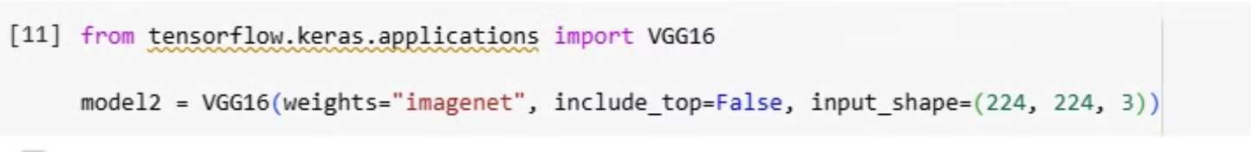
Model Architecture
Choose a Pre-trained Model:
Examples: VGG16, ResNet50, DenseNrt121 (available in keras.applications).
Best Model: VGG16
Load the Model with Weights:
Load the model with weights pre-trained on a dataset like ImageNet.

Slide 17
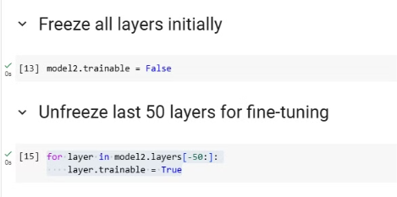

Model Training
Freeze Initial Layers:
Freeze the weights of the initial layers to preserve the general features.
Train the Model:
Train the new layers on the new data.

Slide 18
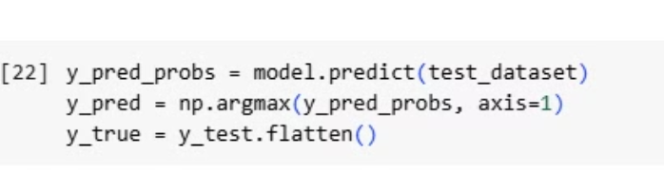
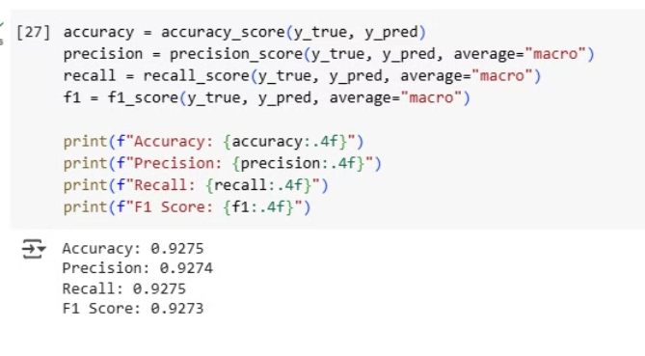
Model Evaluate:
1- Evaluate the trained model on a separate validation set
2- Compute and report metrics

Slide 19
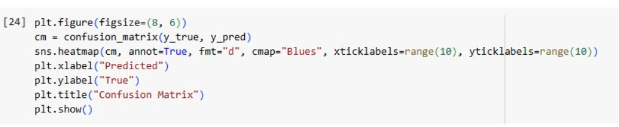
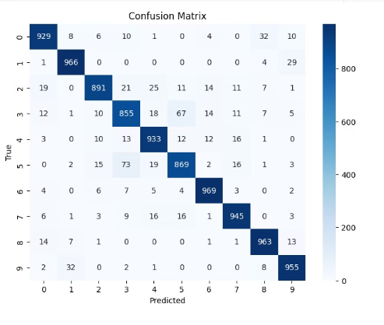
Model Evaluate.(cont)
3-Confusion matrix
output Confusion matrix

Slide 20
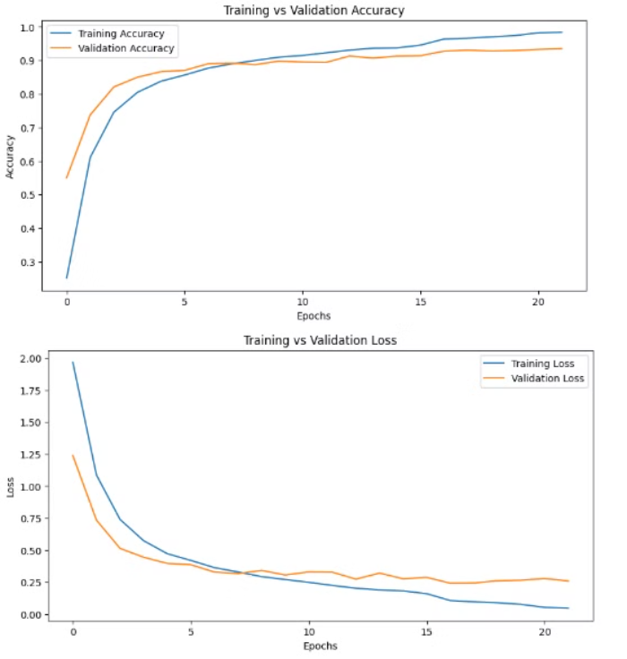
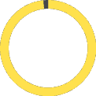


98.38%
92.15%
0.2589
Accuracy
Validation accuracy
Validation loss

Slide 21

Model Development

Slide 22
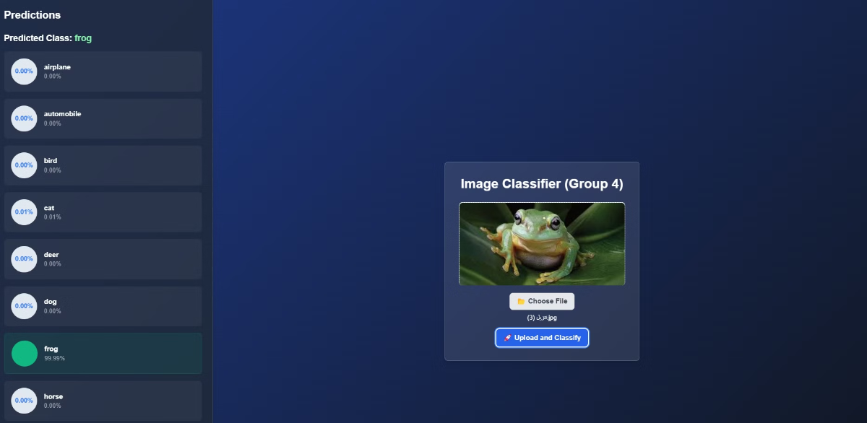
Model Development
This website was developed to display and analyze data using the best model that achieved the highest accuracy in predictions. The site serves as an interactive interface, allowing users to explore the data, view the results, and understand the insights obtained through the model.

Slide 23


You can try it

Slide 24
Thank you

